Slide 1
Airline Customer Satisfaction
Matthew Chan, Rongyu Lin, Rachel Liu

Slide 2
AGENDA
01
Problem
02
About the Dataset
03
Techniques
04
Proposed Solution

Slide 3
01
Problem

Slide 4
Motivation
64.6% decline of global passenger traffic
1 billion less passengers
58.8% decrease in profitability
Neptune
Neptune
Neptune is the farthest planet from the Sun
Neptune is the farthest planet from the Sun
Notes:
https://aci.aero/2021/03/25/the-impact-of-covid-19-on-the-airport-business-and-the-path-to-recovery/ - 1 billion less passengers in 2020
https://www.airlines.org/dataset/impact-of-covid19-data-updates/

Slide 5
With the overwhelming and historic impact of COVID-19 on the airline industry, identifying factors that determine customer satisfaction is essential.
We aim to utilize machine learning to predict whether a future customer will be satisfied with their service based on the selected parameters.

Slide 6
02
About the Dataset

Slide 7
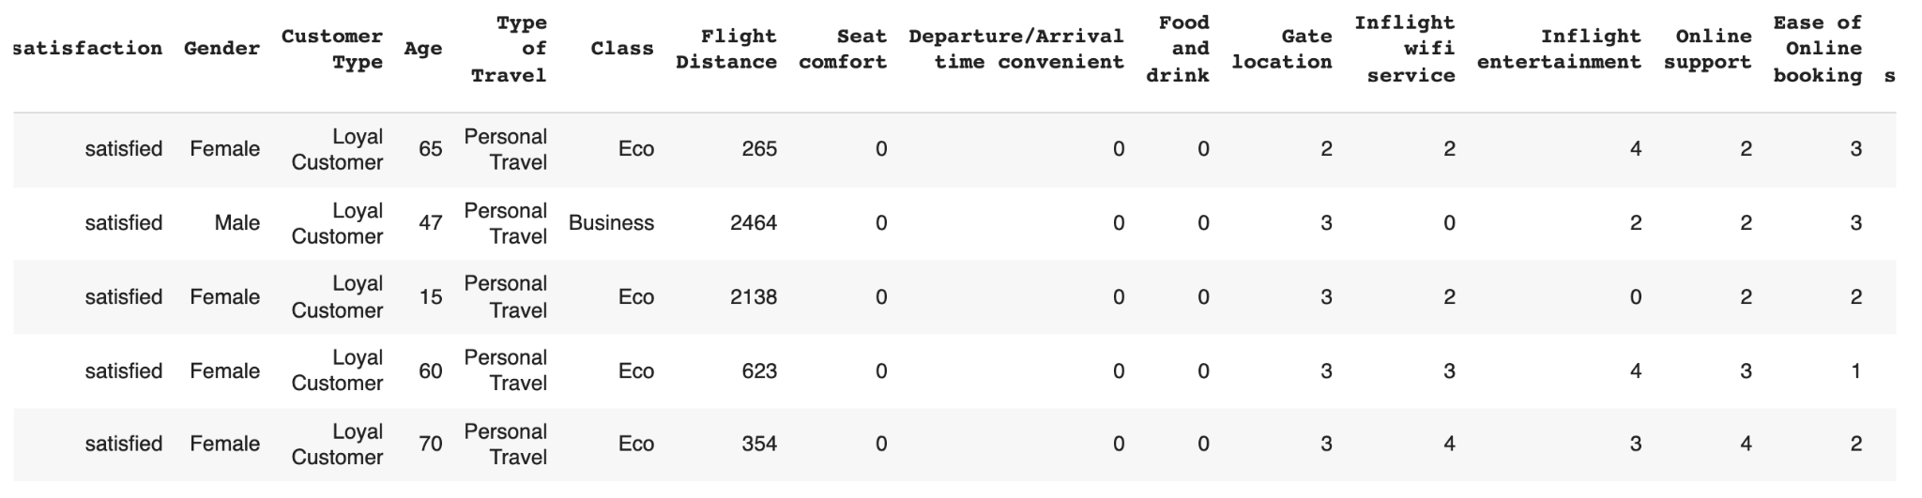
Dataset | https://www.kaggle.com/sjleshrac/airlines-customer-satisfaction
Number of Customers | 129,880
Satisfaction Percentage | Satisfied: 71,087 (54.73%) Unsatisfied: 58,793 (45.27%)

Slide 8
03
Techniques

Slide 9
Techniques Used
Autogluon
SHAP
Tabular Predictions
Model Selection / Ensembling
Feature Importance
Game Theoretic Approach
Feature Importance

Slide 10
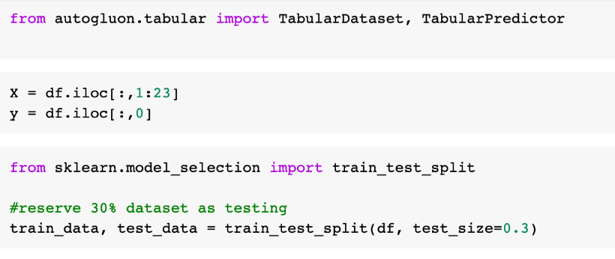

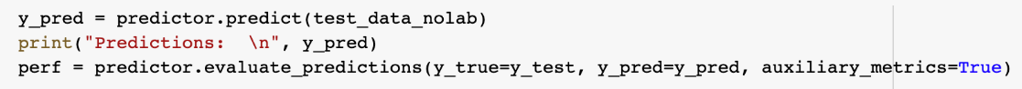
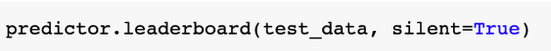
Procedure Autogluon
Train Data
Test Data

Slide 11
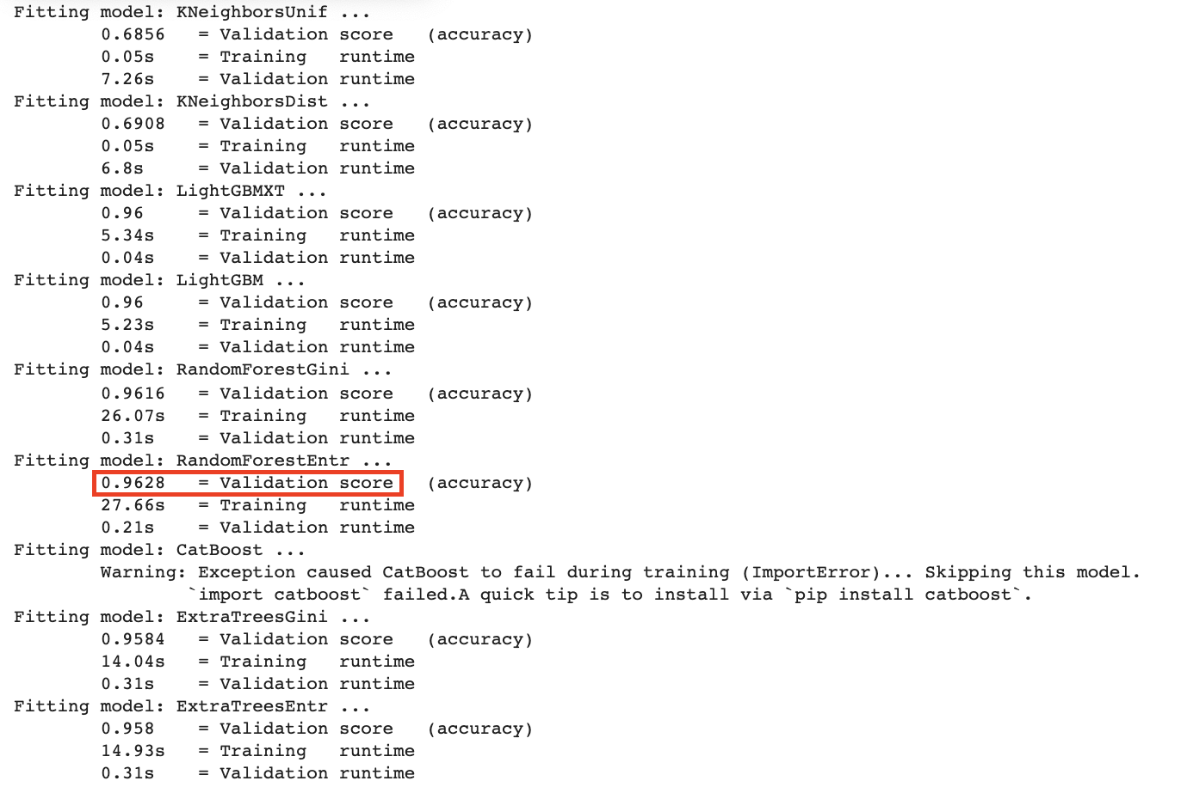
Results Train
Most Accurate Models: RandomForestGini
96.28% Accuracy

Slide 12
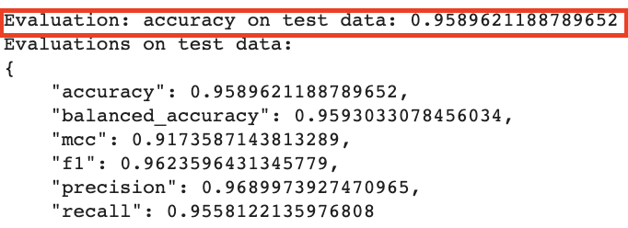
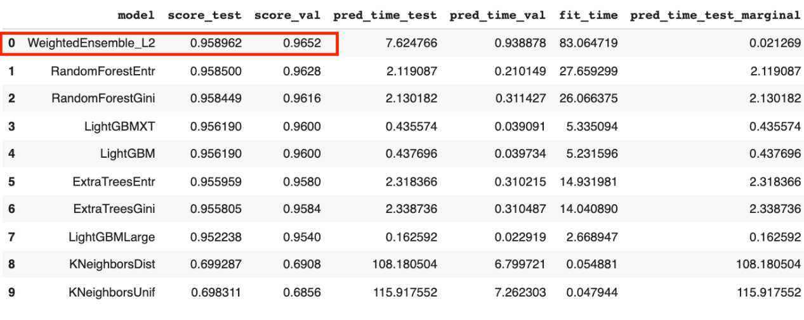
Results Test
Most Accurate Model: Weighted Ensemble L2
95.90% Accuracy

Slide 13
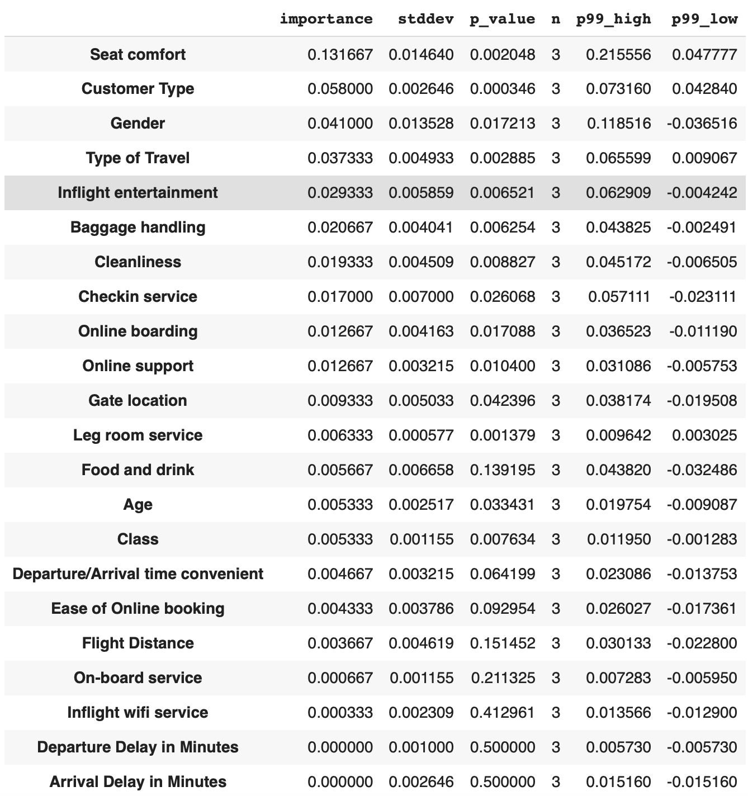
Results Feature
Importance
Most Important Feature: Seat Comfort
0.132

Slide 14
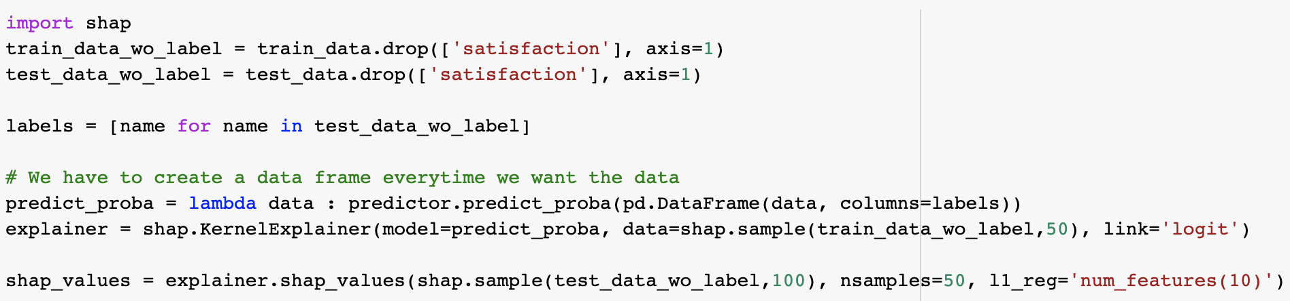
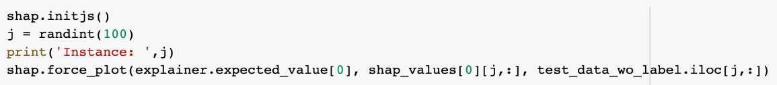
Procedure SHAP

Slide 15
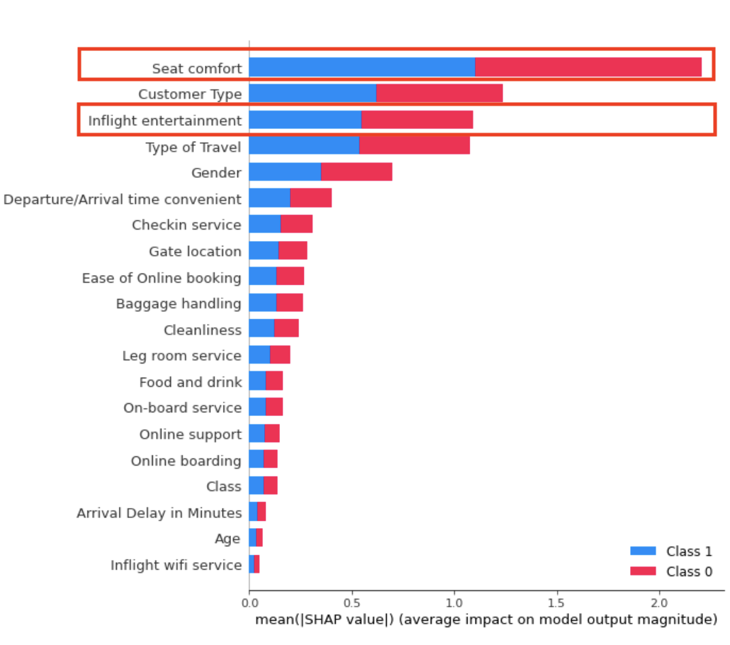
Results SHAP
Most Important Features: Seat Comfort and Inflight Entertainment
Most Important Feature: Seat Comfort
0.13

Slide 16



Results Customer vs Customer
Most Important Feature: Seat Comfort
0.13

Slide 17
In-Flight Features > Pre-Flight Features

Slide 18
04
Proposed Solution

Slide 19
Business Solutions
Increase Seat Width and Incorporate Ergonomic Design
Expand Movie and TV Show Offerings
Increase Screen Sizes
Incorporate gaming
Notes:
https://www.panasonic.aero/blog-post/comfort-and-care-how-airlines-can-improve-the-passenger-experience/
https://www.travelagentcentral.com/transportation/7-ways-flight-entertainment-will-change-future-according-to-man-who-makes-it

Slide 20
GITHUB Links
Matthew Chan
Rongyu Lin
Rachel Liu

Slide 21
ThankYou!

